Slide 1
How (not) to benchmark
July 29, 2022

Slide 2
Agenda
Trends in Biomedical Challenges
Pitfalls in evaluation
What to do?
Your experience

Slide 3
Biomedical challenges

Slide 4
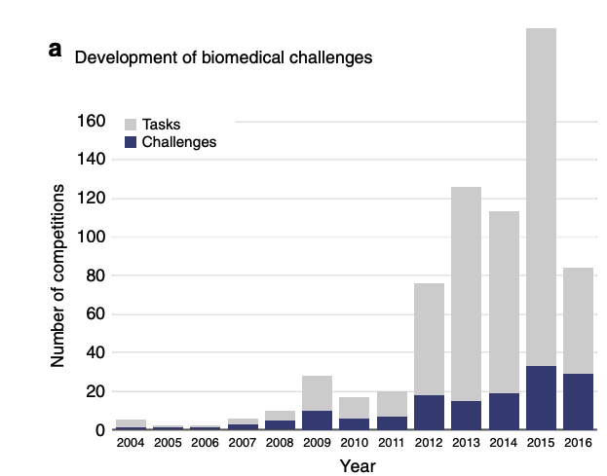
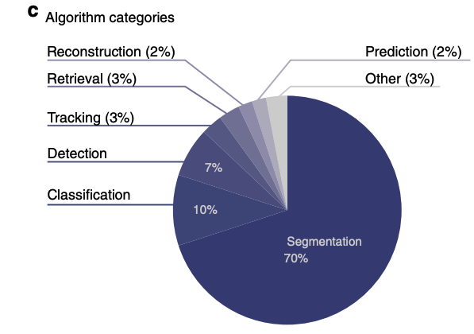
Biomedical Challenges
Why rankings of biomedical image analysis competitions should be interpreted with care, Maier-Hein et al. , Nature Communications

Slide 5
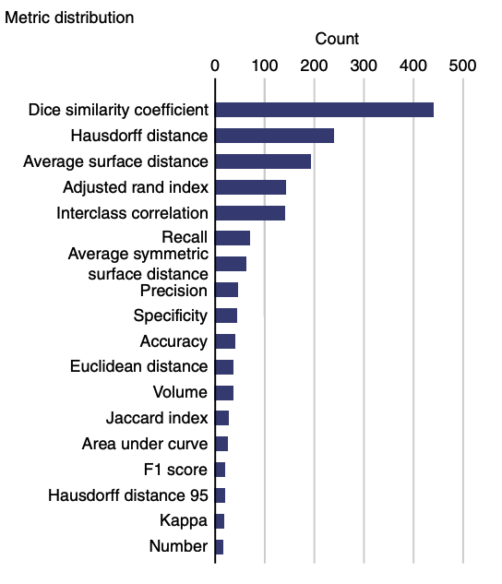
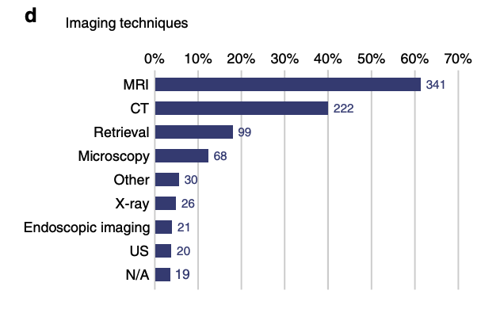
Biomedical Challenges
Why rankings of biomedical image analysis competitions should be interpreted with care, Maier-Hein et al. , Nature Communications

Slide 6
Evaluation pitfalls
Metric dependency
Observer dependency
Aggregation dependency
Missing datapoints

Slide 7
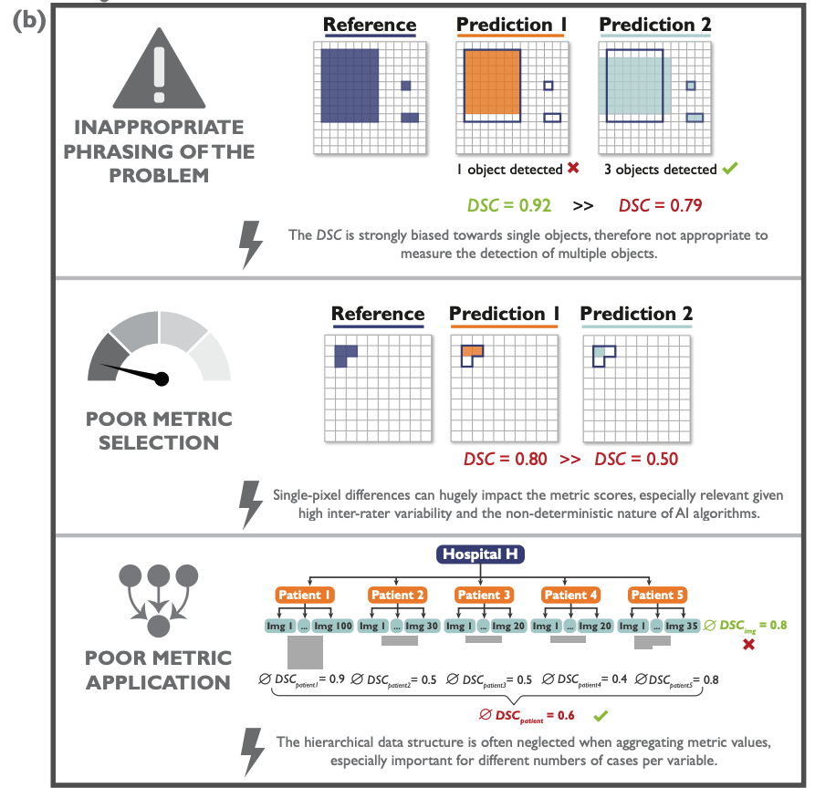
Evaluation pitfalls
Metrics reloaded: Pitfalls and recommendations for image analysis validation, Lena Maier-Hein et al. , arxiv, 2022

Slide 8
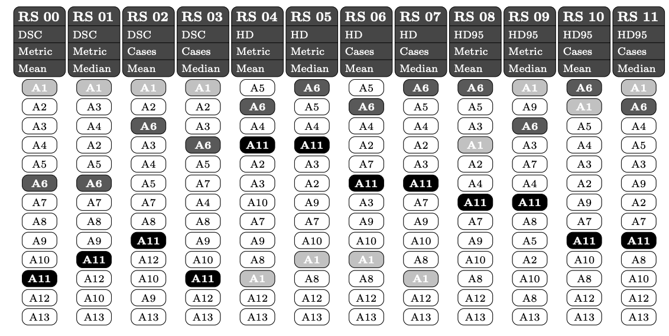
Metric dependency
How to Exploit Weaknesses in Biomedical Challenge Design and Organization, Reinke et al., Lecture Notes in Computer Science, 2018

Slide 9
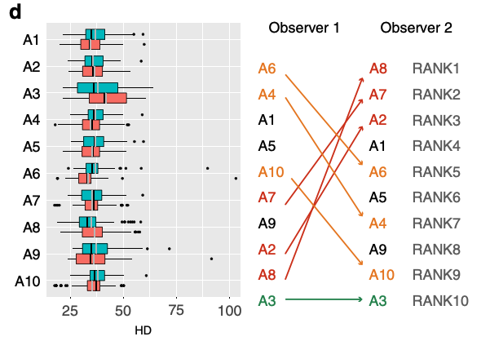
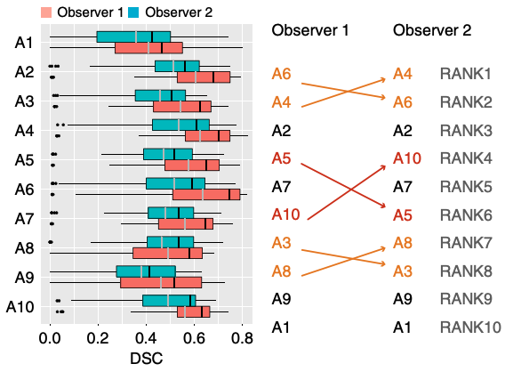
Observer dependency
Why rankings of biomedical image analysis competitions should be interpreted with care, Maier-Hein et al. , Nature Communications

Slide 10
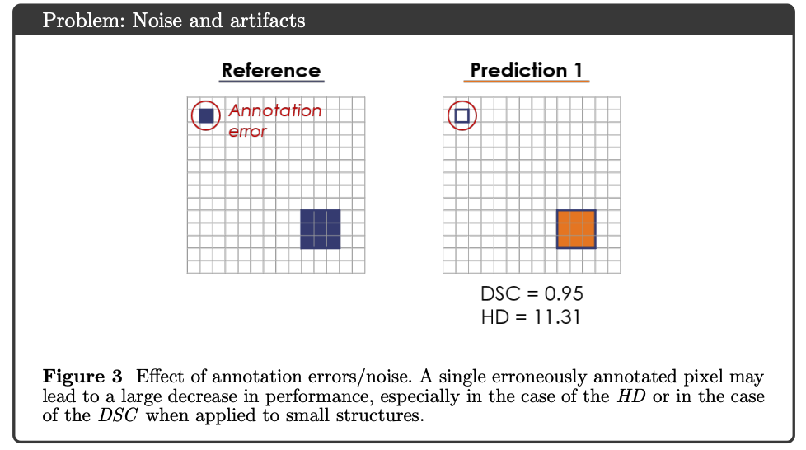
Observer dependency
Common Limitations of Image Processing Metrics: A Picture Story, Reinke et al., Preprint, 2021

Slide 11
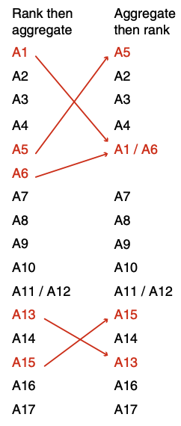
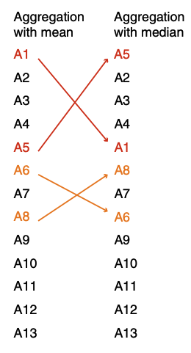
Aggregation
Why rankings of biomedical image analysis competitions should be interpreted with care, Maier-Hein et al. , Nature Communications

Slide 12
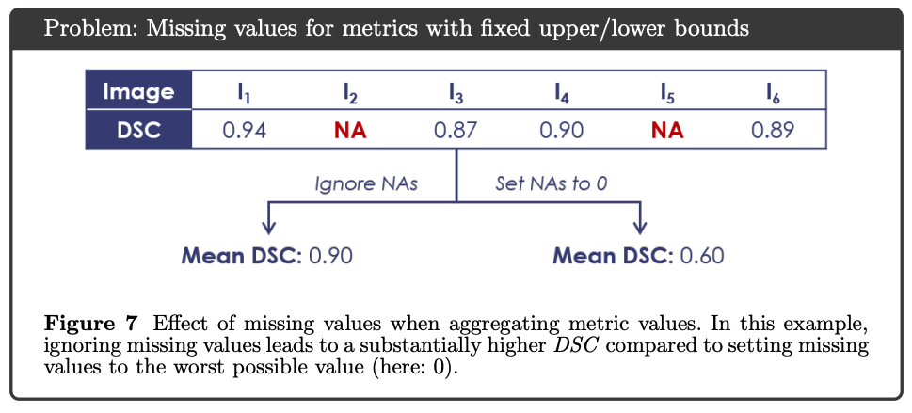
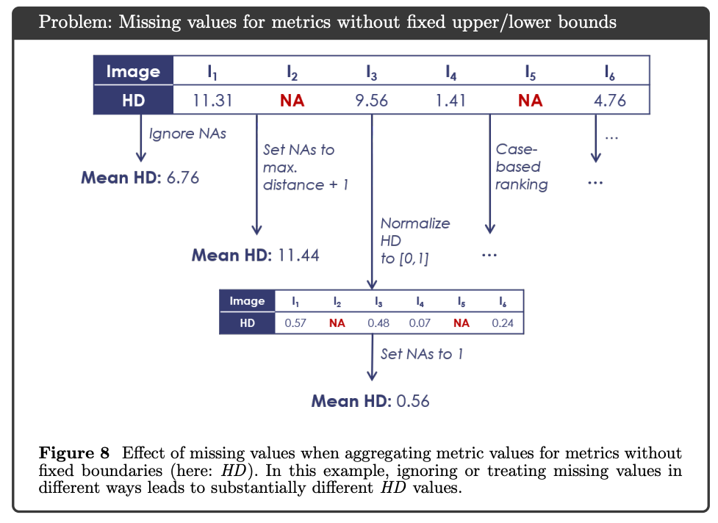
Missing datapoints
Common Limitations of Image Processing Metrics: A Picture Story, Reinke et al., Preprint, 2021

Slide 13
What to do?
Metric dependency
Observer dependency
Aggregation dependency
Missing datapoints

Slide 14
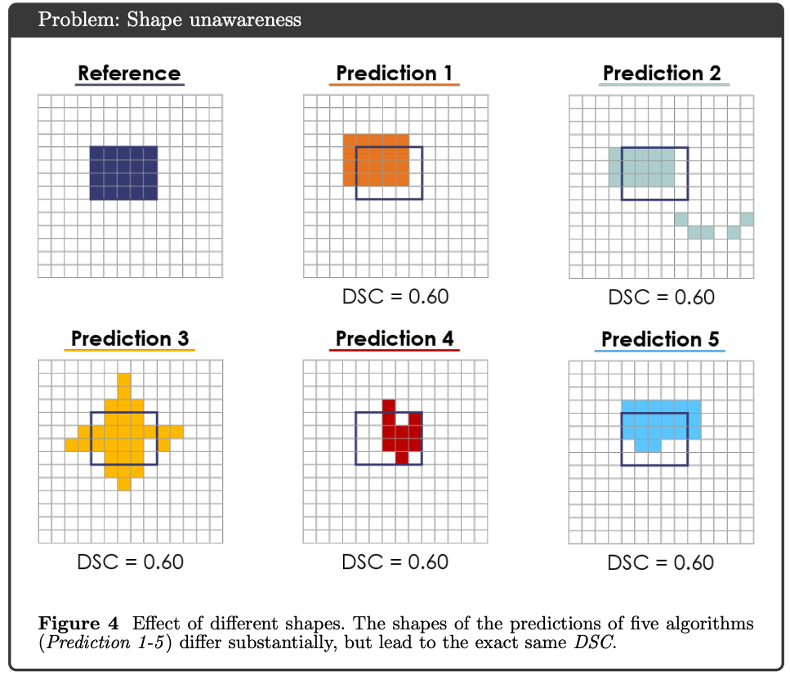
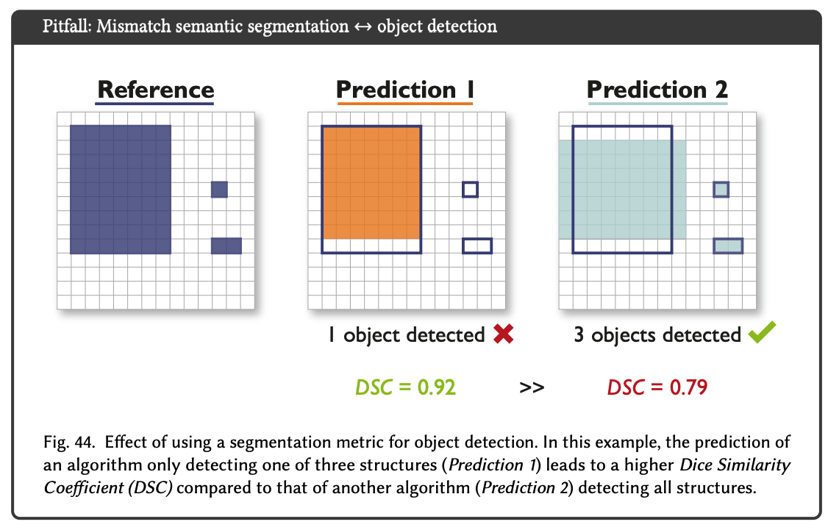
Metric: What is important?
Common Limitations of Image Processing Metrics: A Picture Story, Reinke et al., Preprint, 2021

Slide 15
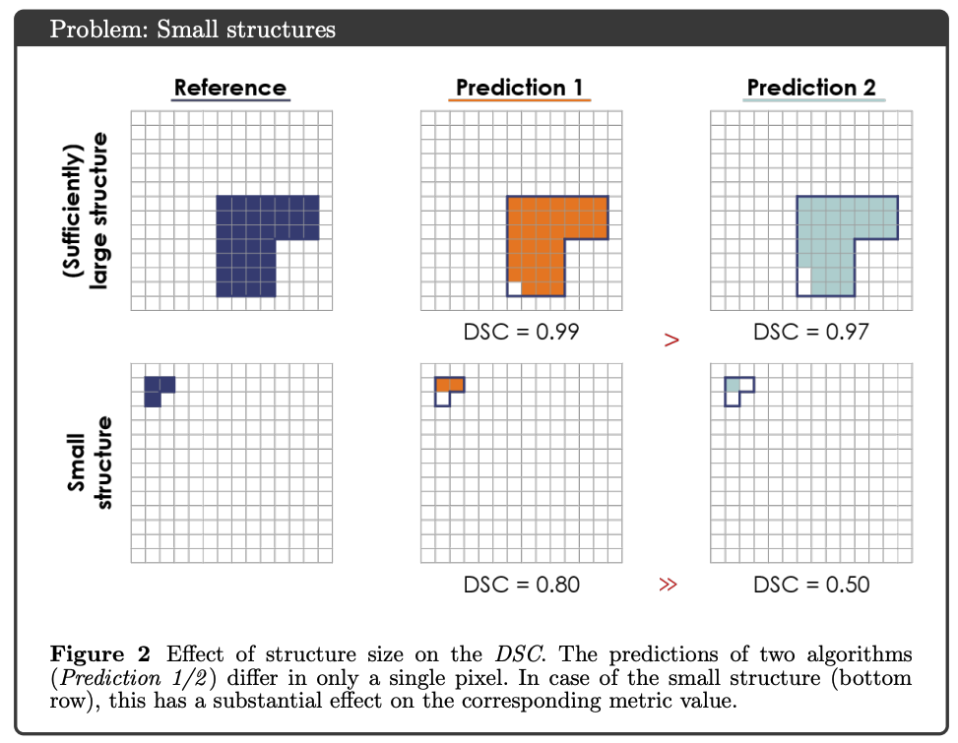

Metric: What is important?
Common Limitations of Image Processing Metrics: A Picture Story, Reinke et al., Preprint, 2021

Slide 16
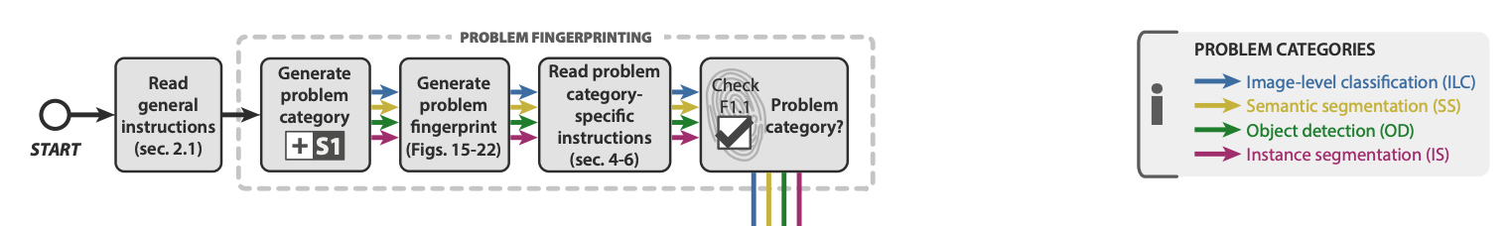
Metric: Which metrics should I use?
Metrics reloaded: Pitfalls and recommendations for image analysis validation, Lena Maier-Hein et al. , arxiv, 2022

Slide 17
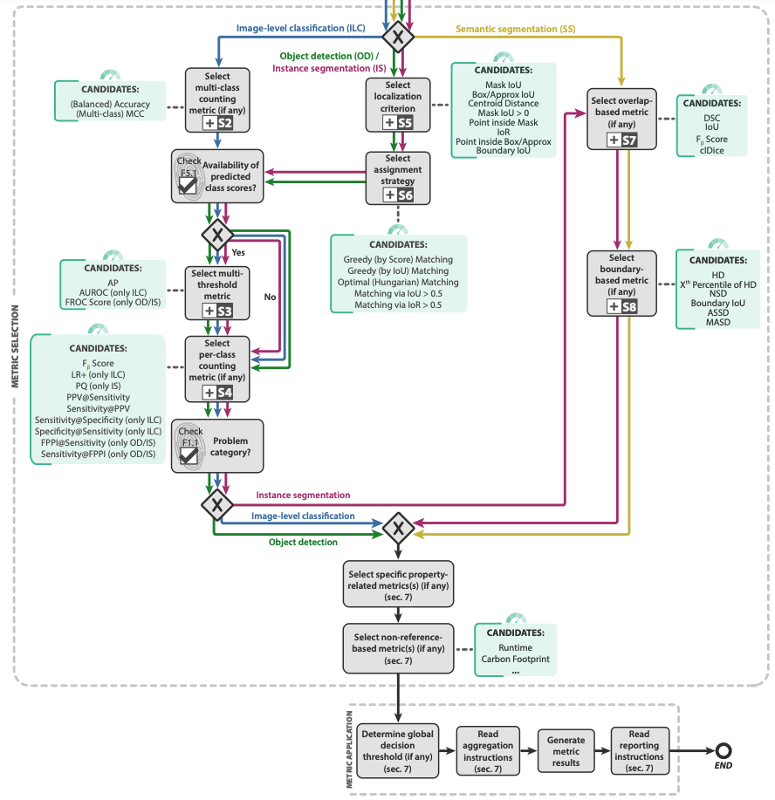
Metric: Which metrics should I use?
Metrics reloaded: Pitfalls and recommendations for image analysis validation,
Lena Maier-Hein et al. , arxiv, 2022

Slide 18
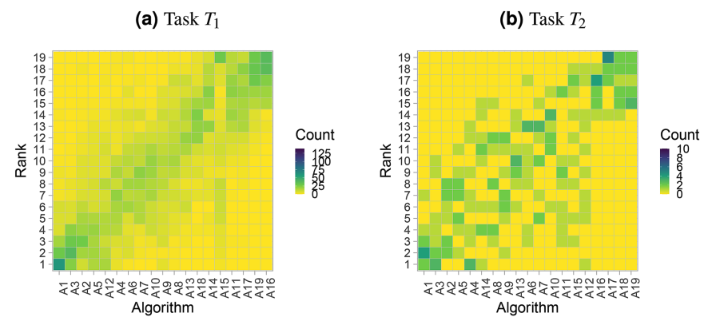
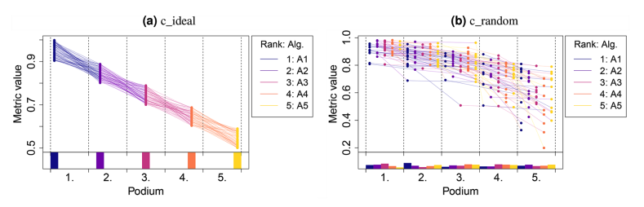
Metric visualization
Evaluate on multiple metrics and visualize well
Methods and open‑source toolkit for analyzing and visualizing challenge results, Wiesenfarth et al., Nature scientific reports

Slide 19
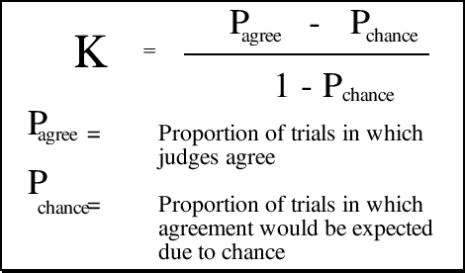

Observer dependency
Have multiple observers or
let one observer reannotate
Measure agreement to different observers (and interobserver)

Slide 20

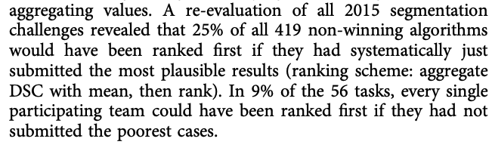
Missing datapoints

Slide 21
Aggregation

Slide 22
What are your experiences?

Slide 23
Summary
- Use different evaluation schemes and visualize results
- Make clear why those metrics were chosen
- Use multiple observers if possible
- Make limitations clear

